Slide 1



DEPARTMENT OF ELECTRONICS AND COMMUNICATIONENGINEERING
18ECP104L-MINOR PROJECT-II
FIRST REVIEW
BLUETOOTH CONTROLLED DATA LOGGER ROBOT FOR SOIL TESTING
BATCH NO: 34
GUIDED BY:
Dr.E.DINESH
PRESENTED BY:
MUTHULAKSHMI M -927621BEC130
MONISHA A - 927621BEC129
NANDHINI G - 927621BEC131
NAVANEETHA S - 927621BEC134

Slide 2
INTRODUCTION
Bluetooth controlled Robot car is controlled by using Android mobile phone ,the same robot car can also be used to control via gesture, obstacle and rf etc.
An application has to be downloaded from play store to control the car in forward, backward, left and right directions.
This robot can be controlled with a smartphone using Bluetooth through an Android app.
Its three sensors can measure four parameters: temperature, humidity, soil moisture, and ambient light intensity in greenhouses, farms, gardens, parks, etc.
Usually robots like robotic hand, agriculture robot, fire-fighting robot, spy robot, snake robot, humanoid, bomb (or mine) diffusing robot operate automatically without any human intervention or are remote-controlled. Remote-controlled robots are mostly wireless.

Slide 3
ABSTRACT
A Bluetooth controlled data logger robot for soil testing would be a robot equipped with sensors to measure various soil properties such as moisture, temperature, and pH.
The robot would use Bluetooth technology to communicate with a nearby device, such as a smartphone or computer, to collect and store data.
The robot could then transmit this data to the device for analysis, allowing for efficient and accurate monitoring of soil conditions. This type of robot could be useful for agriculture, environmental research, and other applications where monitoring soil conditions is important. This project provides an solution for testing of soil.
Keywords— Arduino UNO, LDR , Soil moisture sensor, Temperature and Humidity sensor

Slide 4
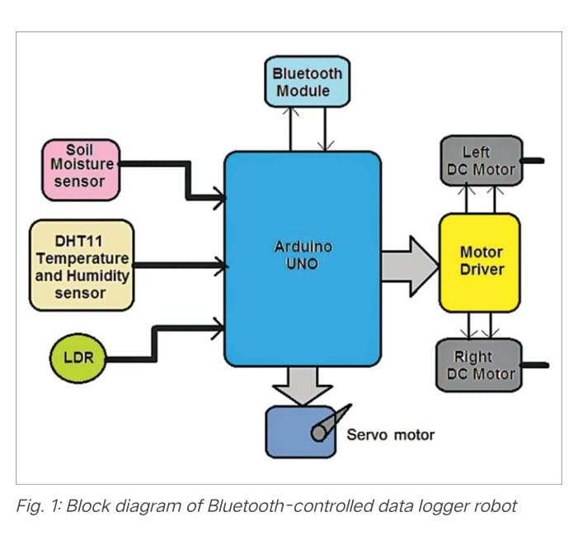
BLOCK DIAGRAM

Slide 5
WORKING
The major building blocks of the system include the three sensors (soil moisture, DHT11 temperature and humidity sensor, and LDR), an Arduino Uno development board, Bluetooth module HC-05, DC servo motor, two DC gear motors, and motor driver chip L293D. Let us first understand the role of the major components used in the project.
Soil moisture sensor (SM1) is used to measure moisture content in soil and give analogue voltage output as per the moisture level. Its output voltage decreases as moisture content increases.
DHT11 temperature and humidity sensor (SM2) is a smart sensor that measures atmospheric temperature and humidity and gives direct digital values for temperature in °C and for humidity in % RH.The light dependant resistor (LDR1) is a photo-conductive device whose resistance decreases as light intensity increases, and vice versa..

Slide 6
WORKING
Bluetooth module (HC-05) is used to command (to move forward, reverse, left, and right) the robot from a smartphone with the help of Arduino Uno microcontroller.
Motor driver L293D (IC1) provides sufficient voltage and current to both the motors to rotate them. It amplifies the output of Arduino board (Board1) and drives the motors.The DC motors (M1 and M2) drive left and right wheels of the robot and move it forward, backward, left, and right.
Soil moisture sensor (SM1) is attached to servo motor (M3) shaft. This motor moves the sensor up and down to insert it into the soil to check soil moisture content.
HC-05 module operates on 5V received from the Arduino board. It communicates with Arduino board with USART pins Tx (D1) – Rx (D0). So, its Tx pin is connected to Rx pin of Arduino board and vice versa.
DHT11 sensor also gets its 5V supply from Arduino board. Its digital output is connected to digital pin D7 of Arduino.

Slide 7
SOFTWARE
The program code (BT_controlled_robot.ino) is written in Arduino programming language. It was tested using Arduino IDE version 1.8.18.
Before compiling and uploading the code, make sure you include the relevant libraries, such as DHT_sensor_library-1.4.2 and DHT sensor library version 1.4.3.
During testing it was found that without these libraries the code could not be compiled.

Slide 8
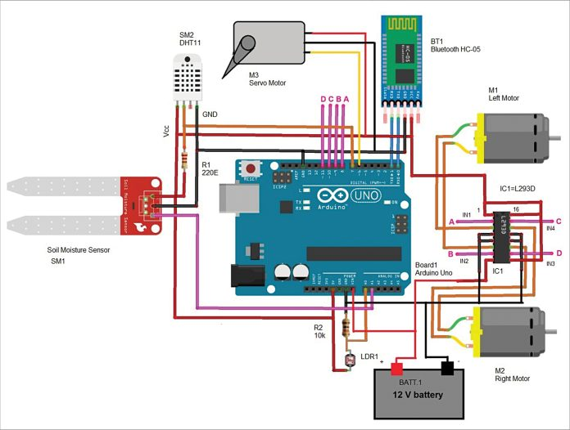
CIRCUIT DIAGRAM

Slide 9
CIRCUIT AND OPERATION
The circuit operation starts when 12V battery is connected to Arduino Uno board and L293D chip.
Initially, both motors (M1 and M2) are at rest and so the robot is also at rest.
The servo motor (M3) is at 0° position and soil moisture sensor is in upward position.
To move the robot in any direction, command is required from smartphone through Bluetooth based Android application, called Bluetooth Terminal HC-05 by mighty IT.
To do this, open (start) Bluetooth Android application in smartphone and search for HC-05 Bluetooth module.
Once the phone detects HC-05 module, pair it with the smartphone’s Bluetooth app.
Enter passkey 1234 or 0000 the first time to pair with HC-05 module.

Slide 10
CIRCUIT AND OPERATION
Now you can send commands from the smartphone to robot to move using the app.
Following commands given in the table are used to move the robot (all these commands are already set in Android application):
When any of the above commands is sent (by sending the character in capital letter), it is received by HC-05 module.
The module further gives this command to Arduino serially through its Tx-Rx pins. Arduino gets this command and compares it with set commands.
If they match, the robot moves in the desired direction.

Slide 11
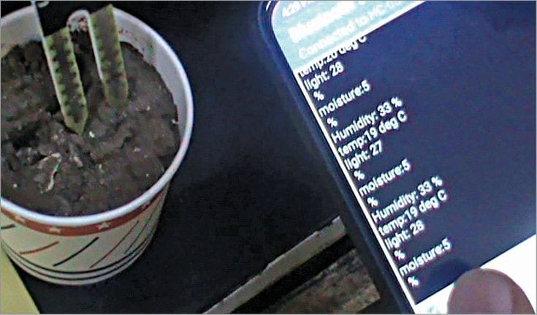
RESULT

Slide 12
REFERENCE
Jeff Daniels, “Future of farming: Driverless tractors, ag robots”, CNBC News, 16th September 2016https://www.cnbc.com/2016/09/16/future-of-farming-driverless-tractors-ag-robots.html
Danny Lipford, “How to Measure Soil Temperature for Planting”, Today’s Homeownerhttps://todayshomeowner.com/how-to-measure-soil-temperature-for-planting/
Ferdinand Pierre Beer, “Vector Mechanics for Engineers, Statics and Dynamics-5th Edition”, McGraw Hill Education
Jim Blom, “Bluetooth Basics”, Learn.sparkfun.comhttps://learn.sparkfun.com/tutorials/bluetooth-basics/all

